Slide 1
YOYO Training 2025
Returning Interviewers

Slide 2
Housekeeping
If you have questions during the training, please unmute yourself or use the chat feature.
Remember to keep yourself muted when not speaking.
If you’re here as a group, please put your individual names in the chat for attendance purposes.
Closed captions are available.

Slide 3
What We’ll Cover Today
Contacting former students
Why we collect Post-School Outcome (PSO) data
Utilizing the Data Collection & Reporting site
Directing former students to resources
Interviewing skills

Slide 4
Contacting Former Students

Slide 5
Contacting Former Students - 1
Inform former students that you will be contacting them approximately 2 weeks before you plan to start contacting them.
Former Student Letter: www.kypso.org/resources/
You may have better methods of contacting former students. If so, use them!
Check your list early. The YOYO begins on April 1, 2025!
Consider hard-to-reach students.
You may get help from your LEA Homeless Coordinator, IC Rep, or Attendance Clerk.

Slide 6
Contacting Former Students - 2
You can find student contact information in Infinite Campus.
Or – use the contact information you collected from your students before they exited HS.
Work with your DoSE to see what may be available. Think ahead for ways to gather this information for next year’s YOYO!
Districts with consistently high contact rates make strong efforts to collect up-to-date contact information on students before they exit HS.

Slide 7
Adding/Deleting Students
To add students:
Download “Add Students Spreadsheet” from kypso.org.
Fill out all information.
Upload it to our secure Student Information Portal on kypso.org.
To delete students:
Document reason for deletion (usually an IC screenshot).
Upload it to our secure Student Information Portal on kypso.org.
In all cases, KYPSO will make the final decision regarding who can be added or removed.
We will often consult with KDE.

Slide 8
A Few Reminders
The YOYO is a federal and state requirement and a way to assist you in improving transition outcomes.
The YOYO and all its items are voluntary for respondents.
But you are required to make every attempt.
Ensure respondents that their information is being kept private.
Will not impact benefits.
They cannot be identified in any report.

Slide 9
Utilizing the Data Collection & Reporting Site

Slide 10
Trouble Accessing the System?
We can provide you with your username.
You will need to reset your password.
You must be assigned a role as an interviewer.
Default will be the same as last year.
Otherwise, we must receive approval from your DoSE.
For questions about accessing the system or help with resetting your password please contact Chelsea.bocard@uky.edu.

Slide 11
Directing Former Students to Resources

Slide 12
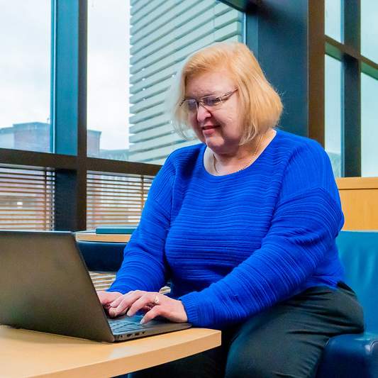
Resource Guide
The top of each section of the YOYO interview provides a link to relevant information in the online Resource Guide.
There is also a Supplemental YOYO Resource Manual available on the KYPSO website.
kypso.org/resources/
resources.hdiuky.org/
Have the Resource Guide open while interviewing.
If possible, send links to former students.

Slide 13
Interviewing Skills

Slide 14
Competitive Integrated Employment Item
Items were added in 2019 regarding integrated setting, comparable pay, benefits, and opportunities for advancement. We realize that these are difficult questions for anyone to answer.
Selecting “Don’t Know” is perfectly acceptable and will not result in the former student being considered non-competitively employed.
Do your best to determine if you think their job meets the underlying concepts of these items.
The military is considered employment.

Slide 15
Guardianship Item
The former student is asked, “Do you have a legal guardian?”
The student may not know, and that’s ok.
Just select the “Not Sure” option.
If the former student (or their parent) is interested in learning about guardianship and its alternatives, you might refer them to My Choice Kentucky (www.mychoiceky.org/)

Slide 16
General Probes
General probes can be used for almost any question.
Examples:
“What do you mean by that?”
“Please tell me more about that.”

Slide 17
Specific Probes
Agencies & People
We don’t know the name of every agency or person in the state.
For agencies, please don’t use abbreviations that are not obvious (OVR is okay).
Please tell us what service the agency provides (college tuition, supported employment, personal care, etc.)
For people, do not use names. Tell us what they do and how they were helpful (or unhelpful).

Slide 18
Specific Probes - 1
Activities
“What do you do on most days?”
Please probe if they say, “Stay home.”
Ask them how they spend their time at home.
Are they watching TV?
Spending time with family?
Working on a hobby at home?
Staying home by themselves and not engaging in any activity?

Slide 19
Specific Probes - 2
Postsecondary Education
We often hear references to a lack of contact with the Disability Services Center (DSC).
Good probes would be:
“Why did you not contact DSC?”
“Was it because you did not want to be identified?”
“Was the DSC unavailable or unhelpful?”
“Something else?”

Slide 20
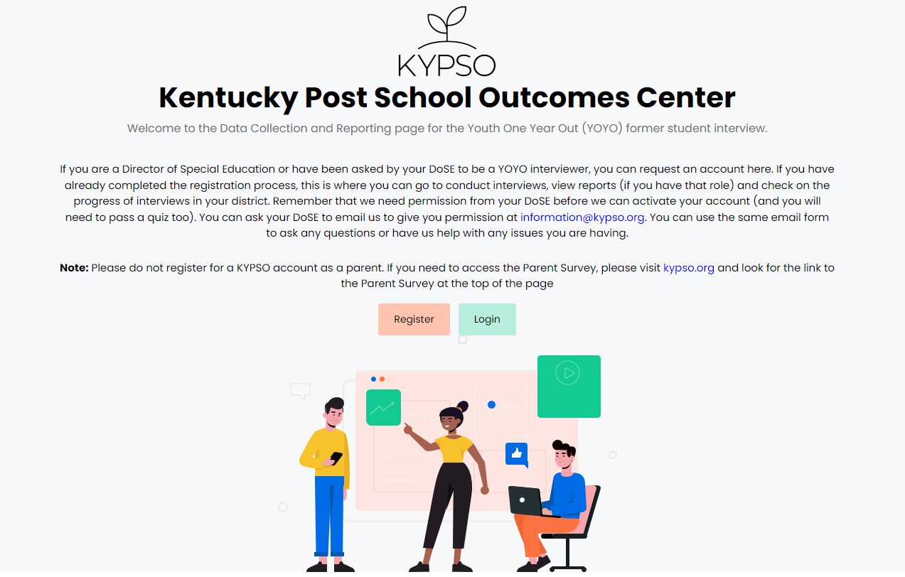
Let’s Look at the YOYO!
kypsodata.org/

Slide 21
Contact Us
Contact Us
KYPSO email: information@kypso.org
KYPSO website: www.kypso.org/
KYPSO Data Collection & Reporting Site: kypsodata.org/
KYPSO Facebook page: facebook.com/KyPSO1/
KYPSO & YOYO Discussion Forum (private FB group): facebook.com/groups/1247375618932347

