Slide 1
YOYO Training 2025
New Interviewers

Slide 2
Housekeeping
If you have questions during the training, please unmute yourself or use the chat feature.
Remember to keep yourself muted when not speaking.
If you’re here as a group, please put your individual names in the chat for attendance purposes.
Closed captions are available.

Slide 3
What We’ll Cover Today
Why we collect Post-School Outcome (PSO) data
How we collect PSO
Roles and responsibilities of interviewers
Contacting former students
Interviewing skills
Directing former students to resources
Utilizing the Data Collection & Reporting site

Slide 4
Why We Collect Post-School Outcome Data

Slide 5
Federal Requirement
U.S. Department of Education, Office of Special Education Programs
All states are required to report the “percent of youth who are no longer in secondary school, had IEPs in effect at the time they left school, and were:
Enrolled in higher education within one year of leaving high school.
Enrolled in higher education or competitively employed within one year of leaving high school.
Enrolled in higher education or in some other postsecondary education or training program; or competitively employed or in some other employment within one year of leaving high school”.
(20 U.S.C. 1416(a)(3)(B))

Slide 6
State Requirement
The Kentucky Department of Education (KDE) wants to help districts improve transition outcomes.
KDE contracts with the Kentucky Post School Outcomes Center (KYPSO) to develop the Youth One Year Out (YOYO) former student interview, collect secondary data, analyze, and report.
KDE wants to know about items in addition to Indicator 14:
Residence
Support services
Community engagement

Slide 7
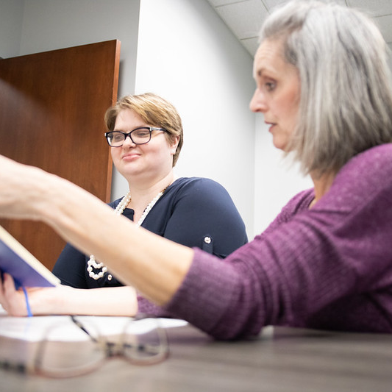
To Help Districts and Educators Make Informed Decisions!
Directors of Special Education (DoSE’s) can examine district reports.
KYPSO staff and Transition Consultants can work with you to identify ways to improve outcomes.
As an interviewer, you can provide former students with access to resources.
Hear first-hand stories about your former students and use that knowledge to help others.

Slide 8
How We Collect Post-School Outcome Data

Slide 9
The Youth One Year Out (YOYO) Interview
An online interview of about 35 questions
The system tells you who to contact
How to contact them (usually)
What questions to ask
How to provide support if needed

Slide 10
Who Should Be Interviewed?
Any student that exited in the 2023-24 school year, had an IEP in place at the time of exit, and exited by:
Graduation with a regular diploma
Graduation with an alternative diploma
Reaching maximum age
Dropping out
KYPSO works with KDE to identify these former students, assign them to the correct district.

Slide 11
Sometimes It Doesn’t Work...
If a student “exits” in 2023 or 2024 but re-enrolls before the YOYO starts, they should be removed.
If a student moves to another district but never enrolls there, they are considered a dropout from your district.
Sometimes students who are on your list should not be.
It’s important for you to obtain up-to-date contact information.

Slide 12
What To Do?
To add students:
Download “Add Students Spreadsheet” from kypso.org.
Fill out all information.
Upload it to our secure Student Information Portal on kypso.org.
To delete students:
Document reason for deletion (usually an IC screenshot).
Upload it to our secure Student Information Portal on kypso.org.
In all cases, KYPSO will make the final decision regarding who can be added or removed.
We will often consult with KDE.

Slide 13
Roles and Responsibilities of Interviewers

Slide 14
Being a YOYO Interviewer is a Big Responsibility
You are collecting data that tells us about Post School Outcomes of Former Students (FS) with disabilities across Kentucky.
The information you collect will be compiled and reported to districts, the state, and federal governments
Important decisions will be made based on these reports and recommendations.
The information you obtain can help future students be more successful after high school. It might even help the very student you are talking with!
Remember, you may be the last person from the school to ever speak with this FS again! So, it’s important to show the FS you care about them and what is happening in their life now that they’re on their own.

Slide 15
Confidentiality
Youth are protected by ensuring that all their personal information is confidential.
All paper and electronic information containing Personally Identifiable Information (PII) must not be available to anyone outside of school personnel with designated access.
Never leave YOYO materials in public (e.g., leaving your computer screen open to a former student interview).
Never allow unauthorized persons to look at them.
Notify your supervisor if you lose any confidential materials.
Never talk about who you interviewed or what they say.

Slide 16
Contacting Former Students

Slide 17
Response Rates
Every interview will end in one of four ways:
You’ll make contact and complete an interview (~60%)
You’ll make contact, but they’ll refuse to be interviewed (~4%)
You’ll be unable to make contact (~35%)
You’ll make no attempt to conduct an interview (~1%)
Each of these rates is reported to the state.
We understand that not all former students can be contacted. But there are ways to increase response rates!
There is no excuse for not making an attempt.

Slide 18
Can I Interview a Family Member?
Yes! You can interview a family member if you cannot get in touch with the former student or if the former student says they want their family member to answer their questions.
This is typically the case with 1/3 of completed interviews.
Remember – it’s the former student’s answers that we want, not the parents.
Ask the parent how their son/daughter would likely respond.

Slide 19
Contacting Former Students
You can find student contact information in Infinite Campus.
Or – use the contact information you collected from your students before they exited HS.
Work with your DoSE to see what may be available. Think ahead for ways to gather this information for next year’s YOYO!
Districts with consistently high contact rates make strong efforts to collect up-to-date contact information on students before they exit HS.
If you have better methods of contacting former students, use them!
They don’t have to respond, but you have to try.
They may not want to talk to someone from the school.
Be personable and open
Start early!
The YOYO opens on April 1, 2025.

Slide 20
Inform Former Students That You Will Be Contacting Them
Former students should be informed of the fact that you will be contacting them approximately 2 weeks before you plan to start contacting them.
The easiest way to do this will be to send a Former Student Letter. A sample letter can be found at kypso.org/resources.

Slide 21
Be Prepared to Interview
Computer with internet access.
Telephone with speakerphone capability or headset.
Approximately 15 minutes per interview.
Quiet area as free of distraction as possible.
You may want to post a sign on the door of the office/area you use to notify people of a telephone interview.
Know who you are calling.
Do they have communication needs?
Do you remember anything personal about them?

Slide 22
What If I Just Can’t Get In Touch With Someone?
If you have exhausted all options, or tried at least three phone calls with no response, simply mark “Could Not Contact” and submit the interview. Never complete the interview according to how you think they would answer.
Remember, you can also interview the respondent in person. Some interviews have even texted questions one by one.
Try calling during the evening or on weekends. Be creative but not invasive.

Slide 23
What If I Get Voicemail?
You can use this script:
“Hello, this is ______ calling from ______ school. I am calling for Former Student Name. I want to know if you would like to participate in an interview we are conducting with former students to see how things are going. You can return my call at ______. I will also try to call you another time. Thank you”.
You can also text them to try to set up a time to conduct the interview

Slide 24
What Can I Say to Encourage Participation?
Inform the Former Student (FS) that the survey is voluntary.
Inform the FS that they can refuse to answer any particular question.
Assure the FS that the survey is important to their school district and the state.
Assure the FS that what they say is protected and will be kept private and confidential.
Explain that their name won’t appear in any report and that their responses will be combined with many other surveys.
Inform the FS that they can have someone help them answer any part of or all of the interview.

Slide 25
Interviewing Skills

Slide 26
Be Sensitive and Listen
Some former students who respond to the survey may become upset during the interview.
You ask if they are working, which they desperately want to do, but have not been able to find a job or get the help they need.
It is understandable that they might be very upset by the questions.
This rarely happens, but if it does, it may be necessary to stop the interview, talk with them until they calm down, and then end the call and note why.
The same is true for parents!

Slide 27
Rephrasing
While we want all questions to be asked the same way, we also want to get full and complete answers.
You may need to rephrase certain questions. Do so in a neutral way.
Example: You can say, “From the time you left high school have you ever had a paying job?”
Former student: “What do you mean?”
Bad rephrasing: “You never worked, did you?”
Good rephrasing: “Do you go to work? Do they pay you? Did you ever go to work in the past year?”

Slide 28
Redirecting
Often, former students will give answers that are not relevant to the question being asked.
Be aware of this and try to redirect their response.
Example: You can say, “I’d like to talk more about that later. Can we work on this question first?”
If they’re still not responding to the question being asked, enter their comments at the end of the interview in the interviewer comments section.
Please do not enter those comments under the “other” responses if they’re not answering the question asked.

Slide 29
Competitive Integrated Employment Items
Items regarding integrated setting, comparable pay, benefits, and opportunities for advancement. We realize that these are difficult questions for anyone to answer.
Selecting “Don’t Know” is perfectly acceptable and will not result in the former student being considered non-competitively employed.
Do your best to determine if you think their job meets the underlying concepts of these items.
The military is considered employment.

Slide 30
Guardianship Item
The former student is asked, “Do you have a legal guardian?”
The student may not know, and that’s ok.
Just select the “Not Sure” option.
If the former student (or their parent) is interested in learning about guardianship and its alternatives, you might refer them to My Choice Kentucky (mychoiceky.org/)

Slide 31
Probes
Sometimes, it can be difficult for a young person to fully explain what he or she is trying to get across.
This does not allow for the best data to be captured, nor does it encourage the former student to fully explore her or his thoughts and experiences.
Probes are used to address this.
We have restricted the YOYO to only have a few response options, so probes are very important.

Slide 32
General Probes
General probes can be used for almost any question.
Examples:
“What do you mean by that?”
“Please tell me more about that.”

Slide 33
Specific Probes
Agencies & People
We don’t know the name of every agency or person in the state.
For agencies, please don’t use abbreviations that are not obvious (OVR is okay).
Please tell us what service the agency provides (college tuition, supported employment, personal care, etc.)
For people, do not use names. Tell us what they do and how they were helpful (or unhelpful).

Slide 34
Specific Probes - 1
Activities
“What do you do on most days?”
Please probe if they say, “Stay home.”
Ask them how they spend their time at home.
Are they watching TV?
Spending time with family?
Working on a hobby at home?
Staying home by themselves and not engaging in any activity?

Slide 35
Specific Probes - 2
Postsecondary Education
We often hear references to a lack of contact with the Disability Services Center (DSC).
Good probes would be:
“Why did you not contact DSC?”
“Was it because you did not want to be identified?”
“Was the DSC unavailable or unhelpful?”
“Something else?”

Slide 36
Directing Former Students to Resources

Slide 37
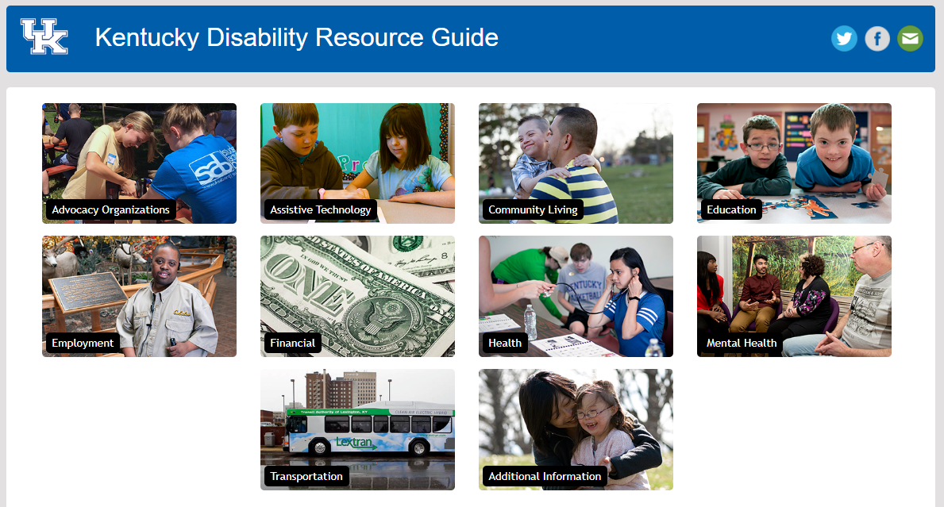
Kentucky Disability Resource Guide
Human Development Institute (HDI) University of Kentucky (UK) Disability Resource Guide
resources.hdiuky.org/

Slide 38
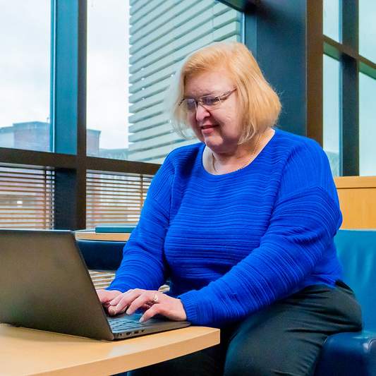
Linking the YOYO to the Resource Guide
The top of each section of the YOYO interview provides a link to relevant information in the online Resource Guide.
Have the resource guide open while interviewing. If possible, send links to former students.
Additional information can be found in the Supplemental YOYO Resource Guide (kypso.org/resources/)
There are many other resources, including transition-related videos, on our Resources page. Feel free to share!

Slide 39
Other Resources
At the end of the YOYO Interview, you may note which, if any, resources you referred the former student to.
Reminder – please don’t list specific teacher/parent/student names in interviewer notes.
The Transition Consultant is the best for general information.
Name and contact information will appear at the end of the YOYO.
Other options:
Vocational Rehabilitation
Medicare/Medicaid
Michelle P. Waiver
Information related to employment (including supported employment)
Information related to higher education
Your personal information

Slide 40
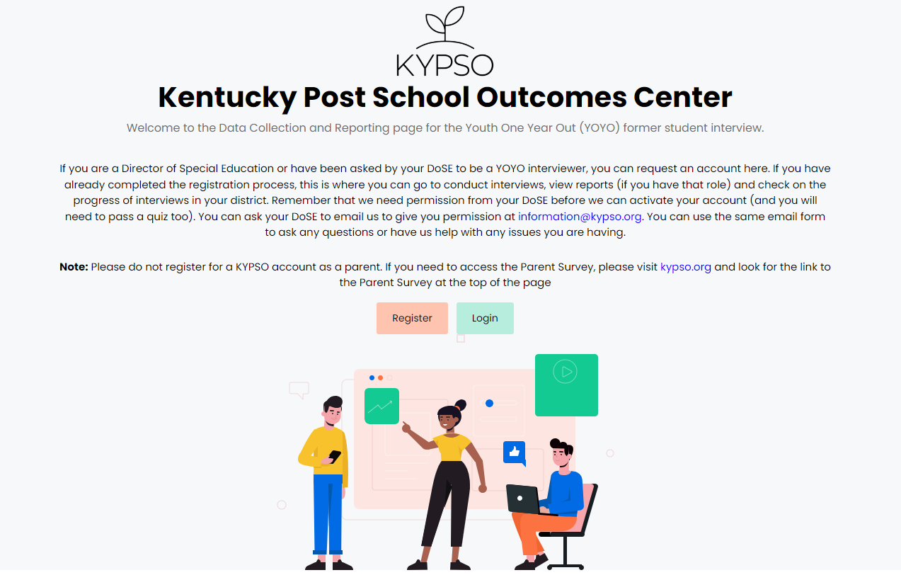
Let’s Look at the YOYO!
kypsodata.org/

Slide 41
Contact Us
Contact Us
KYPSO email: information@kypso.org
KYPSO website: www.kypso.org/
KYPSO Data Collection & Reporting Site: kypsodata.org/
KYPSO Facebook page: facebook.com/KyPSO1/
KYPSO & YOYO Discussion Forum (private FB group): facebook.com/groups/1247375618932347

